Slide 1
Module – 2 Data center environment
Module 2: Data Center Environment
1
Notes:
Module – 2
Data Center Environment

Slide 2
Module 2: Data Center Environment
Upon completion of this module, you should be able to:
Describe the core elements of a data center
Describe virtualization at application and host layer
Describe disk drive components and performance
Describe host access to storage through DAS
Describe working and benefits of flash drives

Slide 3
Module 2: Data Center Environment
Lesson 1: Application, DBMS, and Host (Compute)
During this lesson the following topics are covered:
Application and application virtualization
DBMS
Components of host system
Compute and memory virtualization

Slide 4
Application
A software program that provides logic for computing operations
Commonly deployed applications in a data center
Business applications – email, enterprise resource planning (ERP), decision support system (DSS)
Management applications – resource management, performance tuning, virtualization
Data protection applications – backup, replication
Security applications – authentication, antivirus
Key I/O characteristics of an application
Read intensive vs. write intensive
Sequential vs. random
I/O size

Slide 5
Application Virtualization
Application Virtualization
It is the technique of presenting an application to an end user without any installation, integration, or dependencies on the underlying computing platform.
Allows application to be delivered in an isolated environment
Aggregates Operating System (OS) resources and the application into a virtualized container
Ensures integrity of Operating System (OS) and applications
Avoids conflicts between different applications or different versions of the same application

Slide 6
Database Management System (DBMS)
Database is a structured way to store data in logically organized tables that are interrelated
Helps to optimize the storage and retrieval of data
DBMS controls the creation, maintenance, and use of databases
Processes an application’s request for data
Instructs the OS to retrieve the appropriate data from storage
Popular DBMS examples are MySQL, Oracle RDBMS, SQL Server, etc.

Slide 7
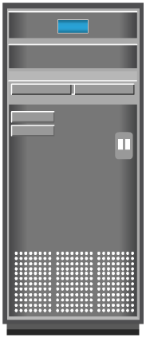








Host (Compute)
Resource that runs applications with the help of underlying computing components
Example: Servers, mainframes, laptop, desktops, tablets, server clusters, etc.
Consists of hardware and software components
Hardware components
Include CPU, memory, and input/output (I/O) devices
Software components
Include OS, device driver, file system, volume manager, and so on
IP

Slide 8
Operating Systems and Device Driver
In a traditional environment OS resides between the applications and the hardware
Responsible for controlling the environment
In a virtualized environment virtualization layer works between OS and hardware
Virtualization layer controls the environment
OS works as a guest and only controls the application environment
In some implementation OS is modified to communicate with virtualization layer
Device driver is a software that enables the OS to recognize the specific device

Slide 9
Memory Virtualization
An OS feature that presents larger memory to the application than physically available
Additional memory space comes from disk storage
Space used on the disk for virtual memory is called ‘swap space/swap file or page file’
Inactive memory pages are moved from physical memory to the swap file
Provides efficient use of available physical memory
Data access from swap file is slower – use of flash drives for swap space gives best performance
Operating System
Memory
Swap in
Swap out
Disk Drive

Slide 10

Logical Volume Manager (LVM)
Responsible for creating and controlling host level logical storage
Physical view of storage is converted to a logical view
Logical data blocks are mapped to physical data blocks
One or more Physical Volumes form a Volume Group
LVM manages Volume Groups as a single entity
Logical volumes are created from the volume group
Logical Volume
Logical Volume
Logical Disk Block
Physical Vol. 1
Physical Vol. 2
Physical Vol. 3
Volume Group

Slide 11
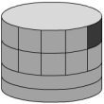
LVM Example: Partitioning and Concatenation
Hosts
Logical Volume
Physical Volume
Partitioning
Concatenation

Slide 12
File System
File System Blocks
Users
Files
File System
1
2
3
Creates/
Reside in
Mapped to
Manages
Disk Physical
Disk Sectors
Extents
LVM Logical Extents
6
5
4
Mapped to
Mapped to
Mapped to

Slide 13

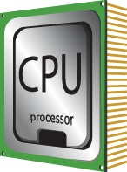
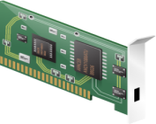
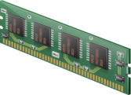
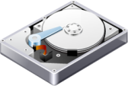
Compute Virtualization
Compute Virtualization
It is a technique of masking or abstracting the physical compute hardware and enabling multiple operating systems (OSs) to run concurrently on a single or clustered physical machine(s).
Enables creation of multiple virtual machines (VMs), each running an OS and application
VM is a logical entity that looks and behaves like physical machine
Virtualization layer resides between hardware and VMs
Also known as hypervisor
VMs are provided with standardized hardware resources
Virtualization Layer (Hypervisor)
x86 Architecture
CPU
NIC Card
Memory
Hard Disk

Slide 14


Need for Compute Virtualization
Virtualization Layer (Hypervisor)
x86 Architecture
x86 Architecture
CPU
NIC Card
Memory
Hard Disk
CPU
NIC Card
Memory
Hard Disk
Before Virtualization | After Virtualization
Runs single operating system (OS) per machine at a time Couples s/w and h/w tightly May create conflicts when multiple applications run on the same machine Underutilizes resources Is inflexible and expensive | Runs multiple operating systems (OSs) per physical machine concurrently Makes OS and applications h/w independent Isolates VM from each other, hence, no conflict Improves resource utilization Offers flexible infrastructure at low cost

Slide 15
Desktop Virtualization
Desktop Virtualization
It is a technology which enables detachment of the user state, the Operating System (OS), and the applications from endpoint devices.
Enables organizations to host and centrally manage desktops
Desktops run as virtual machines within the data center and accessed over a network
Desktop virtualization benefits
Flexibility of access due to enablement of thin clients
Improved data security
Simplified data backup and PC maintenance
Pcs and thin clients
LAN/WAN
Desktop VMs

Slide 16
Module 2: Data Center Environment
Lesson 2: Connectivity
During this lesson the following topics are covered:
Physical components of connectivity
Storage connectivity protocols

Slide 17
Connectivity
Interconnection between hosts or between a host and peripheral devices, such as storage
Physical Components of Connectivity are:
Host interface card, port, and cable
Protocol = a defined format for communication between sending and receiving devices
Popular storage interface protocols: IDE/ATA and SCSI
Host
Adapter
Cable
Disk
Port

Slide 18
IDE/ATA and Serial ATA
Integrated Device Electronics (IDE)/Advanced Technology Attachment (ATA)
Popular interface used to connect hard disks or CD-ROM drives
Available with varity of standards and names
Serial Advanced Technology Attachment (SATA)
Serial version of the IDE/ATA specification that has replaced the parallel ATA
Inexpensive storage interconnect, typically used for internal connectivity
Provides data transfer rate up to 6 Gb/s (standard 3.0)

Slide 19
SCSI and SAS
Parallel Small computer system interface (SCSI)
Popular standard for connecting host and peripheral devices
Commonly used for storage connectivity in servers
Higher cost than IDE/ATA, therefore not popular in PC environments
Available in wide variety of related technologies and standards
Support up to 16 devices on a single bus
Ultra-640 version provides data transfer speed up to 640 MB/s
Serial Attached SCSI (SAS)
Point-to-point serial protocol replacing parallel SCSI
Supports data transfer rate up to 6 Gb/s (SAS 2.0)

Slide 20
Fibre Channel and IP
Fibre Channel (FC)
Widely used protocol for high speed communication to the storage device
Provides a serial data transmission that operates over copper wire and/or optical fiber
Latest version of the FC interface ‘16FC’ allows transmission of data up to 16 Gb/s
Internet Protocol (IP)
Traditionally used to transfer host-to-host traffic
Provide opportunity to leverage existing IP based network for storage communication
Examples: iSCSI and FCIP protocols

Slide 21
Module 2: Data Center Environment
Lesson 3: Storage
During this lesson the following topics are covered:
Various storage options
Disk drive components, addressing, and performance
Enterprise Flash drives
Host access to storage and direct-attached storage

Slide 22
Storage Options
Magnetic Tape
Low cost solution for long term data storage
Preferred option for backup destination in the past
Limitations
Sequential data access
Single application access at a time
Physical wear and tear
Storage/retrieval overheads

Slide 23
Storage Options (contd.)
Optical discs
Popularly used as distribution medium in small, single-user computing environments
Limited in capacity and speed
Write once and read many (WORM): CD-ROM, DVD-ROM
Other variations: CD-RW, Blu-ray discs
Disk drive
Most popular storage medium
Large storage capacity
Random read/write access
Flash drives
Uses semiconductor media
Provide high performance and low power consumption

Slide 24
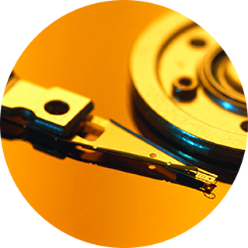
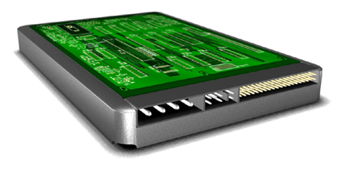
Disk Drive Components
Controller
Board
HDA
Platter and
Read/Write Head
Interface
Power
Connectors

Slide 25


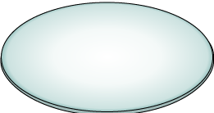

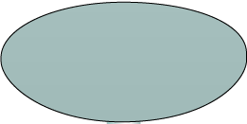



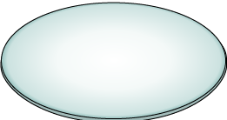

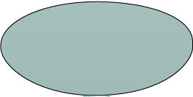








Physical Disk Structure
Spindle
Sector
Sector
Track
Cylinder
Track
Platter

Slide 26
Logical Block Addressing
Sector 8
Block 0
Head 0
(Upper Surface)
Cylinder 1
Block 32
(Lower Surface)
Block 64
Block 128
Physical Address= CHS
Logical Block Address= Block#

Slide 27
Disk Drive Performance
Electromechanical device
Impacts the overall performance of the storage system
Disk service time
Time taken by a disk to complete an I/O request, depends on:
Seek time
Rotational latency
Data transfer rate
Disk service time = seek time + rotational latency + data transfer time

Slide 28
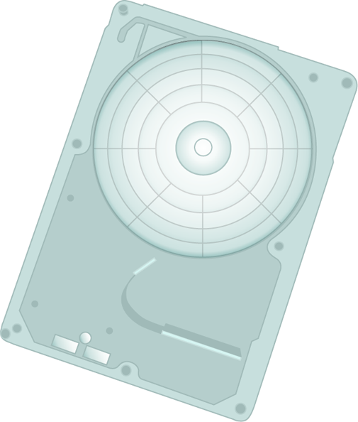
Seek Time
Time taken to position the read/write head
The lower the seek time, the faster the I/O operation
Seek time specifications include
Full stroke
Average
Track-to-track
The seek time of a disk is specified by the drive manufacturer
Radial Movement

Slide 29

Rotational Latency
The time taken by the platter to rotate and position the data under the R/W head
Depends on the rotation speed of the spindle
Average rotational latency
One-half of the time taken for a full rotation
For ‘X’ rpm, drive latency is calculated in milliseconds as:

Slide 30
Data Transfer Rate
Average amount of data per unit time that the drive can deliver to the HBA
Internal transfer rate : Speed at which data moves from a platter’s surface to the internal buffer of the disk
External transfer rate: Rate at which data move through the interface to the HBA
External transfer rate measured here
Internal transfer rate measured here
HBA
Buffer
Head Disk Assembly
Interface
Disk Drive

Slide 31

I/O Controller Utilization Vs. Response Time
Based on fundamental laws of disk drive performance:
Service time is time taken by the controller to serve an I/O
For performance-sensitive applications disks are commonly utilized below 70% of their I/O serving capability
Knee of curve: disks at
about 70% utilization
Response time (msec)
Low Queue Size
100%
0%
Utilization
70%

Slide 32




Storage Design Based on Application Requirements and Disk Drive Performance
Disks required to meet an application’s capacity need (D_{C}):
Disks required to meet application’s performance need (D_{P}):
IOPS serviced by a disk (S) depends upon disk service time (T_{S}):
T_{S} is time taken for an I/O to complete, therefore IOPS serviced by a disk (S) is equal to (1/T_{S})
For performance sensitive application (S)=
Disk required for an application = max (D_{C},D_{P})

Slide 33
Enterprise Flash Drives
Conventional Hard Drives | Flash Drives
Mechanical delay due to seek time and rotational latency | Highest possible throughput per drive due to no mechanical movement
Limited performance and I/O serving capability | Very low latency per I/O and consistent I/O performance
More power consumption due to mechanical operations | High Energy efficiency Lower power requirement per GB Lower power requirement per IOPS
Low mean time between failure (MTBF) | High reliability due to no moving parts
Higher TCO due to more number of disks, power, cooling, and management cost | Overall less TCO

Slide 34

Host Access to Storage
Storage Networking Options
Compute
Compute
Compute
Application
Application
Application
File System
File System
Storage
Network
File-level
Request
Block-level
Request
Storage
Network
Block-level
Network
Request
File System
Storage
System
Storage
Storage
Storage
Direct-Attached Storage
Block-level Access
File-level Access

Slide 35
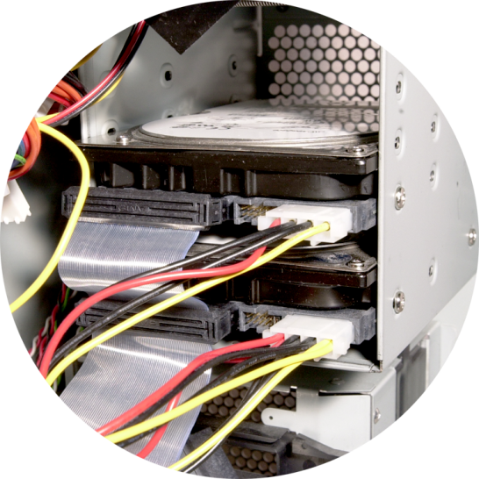
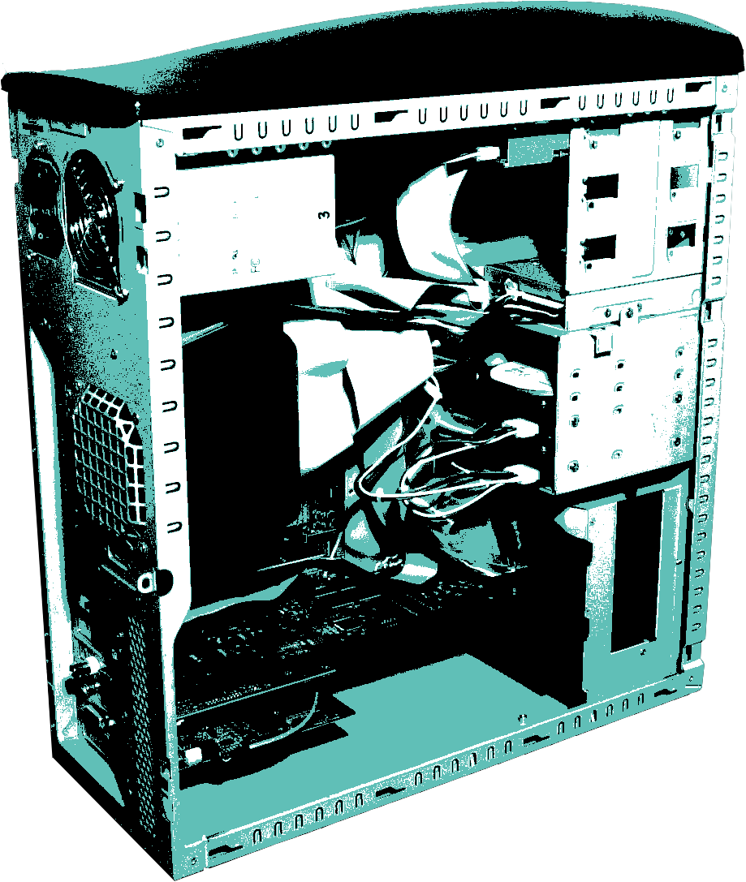
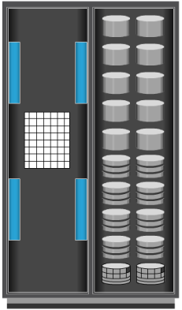
Direct-Attached Storage (DAS)
Internal Direct Connect
External Direct Connect

Slide 36
Module 2: Data Center Environment
Concept in Practice
VMware ESXi

Slide 37
VMware ESXi
Industry’s leading hypervisor
Enable virtualization of x86 hardware platforms
Physical machine that houses ESXi is called ESXi host
ESXi host abstracts physical compute resources to run multiple VMs concurrently on same physical server
Two Components
VMKernel
Work similar to OS – responsible for process creation, resource scheduling, and so on
Virtual machine monitor
Performs binary translation for privileged OS instructions that can not be virtualized

Slide 38
Module 2: Summary
Key points covered in this module:
Key data center elements
Application and compute virtualization
Disk drive components and performance
Enterprise flash drives
Host access to storage

Slide 39
Exercise: Design Storage Solution for New Application
Scenario
Characteristics of new application:
Require 1TB of storage capacity
Peak I/O workload 4900 IOPS
Typical I/O size is 4KB
Specifications of the available disk drives:
15K rpm drive with storage capacity = 100 GB
Average seek time = 5ms
Data transfer rate = 40 MB/sec
As it is business critical application, response time must be within acceptable range
Task
Calculate the number of disks required for the application

